Slide 1
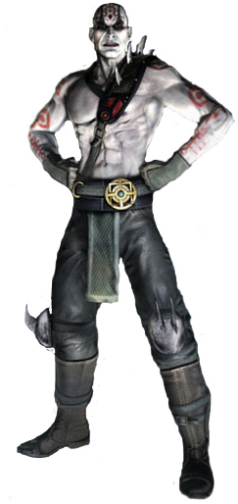
Team "Quan Chi"
team work
GitHub URL
https://github.com/tddold/Team-Quan-Chi-

Slide 2


Team "Quan Chi" members
tddold - Todor Dakov
cdimov - Tsvetomir Dimov
kreato - Angel Stefanov
garmella - Galya Shabanova
slavib - Stanislav Bozhikov
repkata - Ventsislav Angelov
IrinKo - Irina Kostadinova
lubzey - Lyubomir Durankev

Slide 3
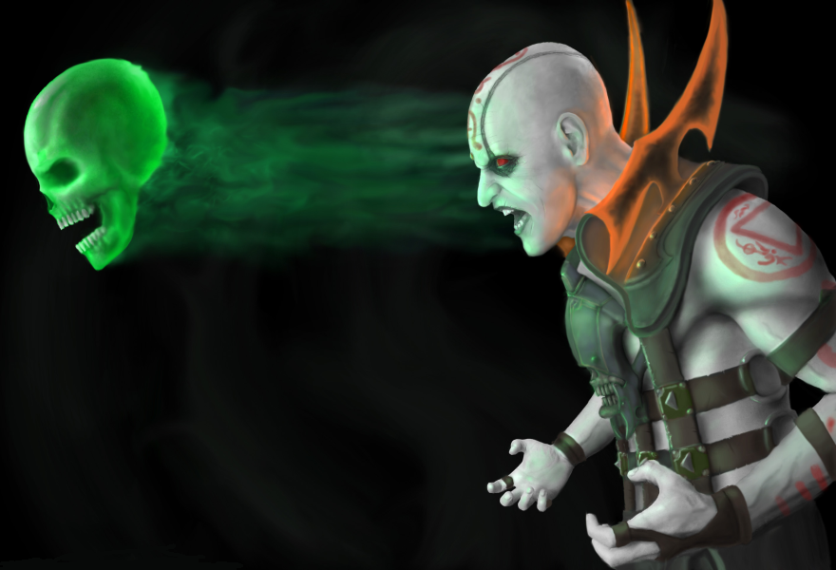
Project explanation
The game is about Quan Chi’s head, which is trying to clear the dark space to reveal the greatest secret of the universe - a hidden picture. However, there is also one BadBoy head that is trying to stop Quan Chi revealing the picture.
If Quan Chi wins, the picture selected from the Welcome menu is displayed, but else BadBoy wins. If Quan Chi manages to reveal the hidden picture, then he goes to the next level, where he has to deal with more and faster BadBoys, so it gets even more difficult.

Slide 4
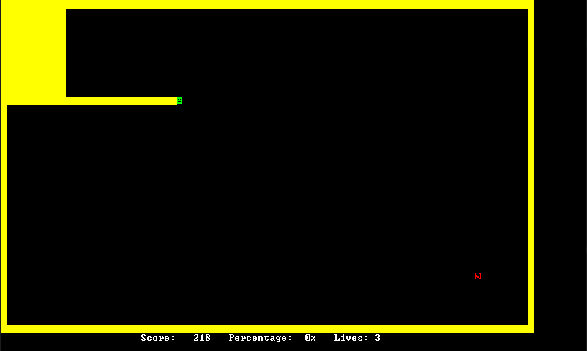
Project explanation
The game is about Quan Chi’s head, which is trying to clear the dark space to reveal the greatest secret of the universe - a hidden picture. However, there is also one BadBoy head that is trying to stop Quan Chi revealing the picture.
If Quan Chi wins, the picture selected from the Welcome menu is displayed, but else BadBoy wins. If Quan Chi manages to reveal the hidden picture, then he goes to the next level, where he has to deal with more and faster BadBoys, so it gets even more difficult.

Slide 5
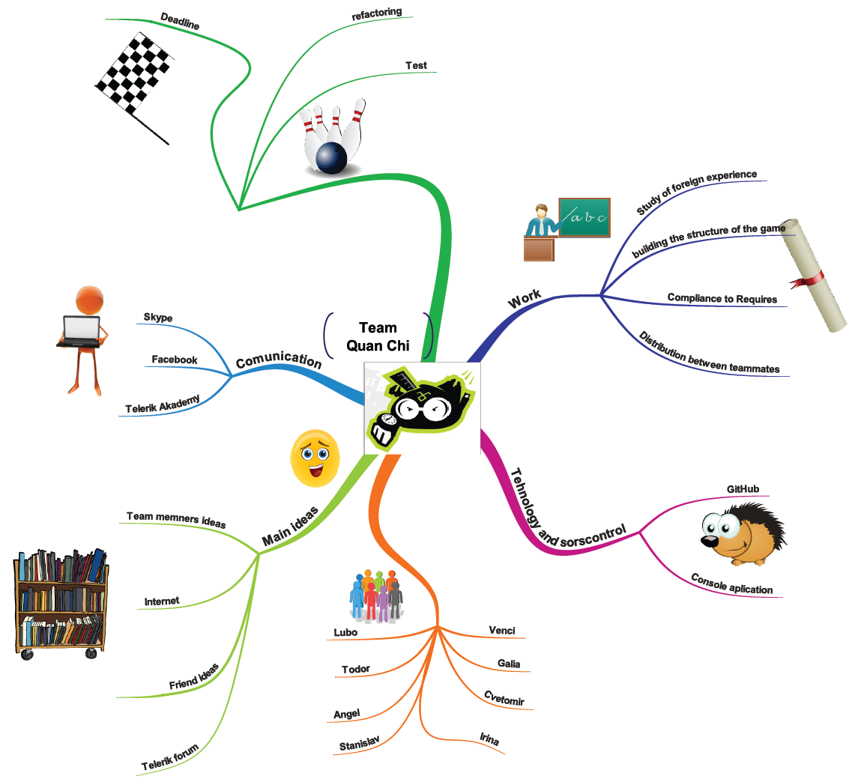
Mind map of the project

